Slide 1

Sales Budget 2020
Presented By: TL Tan
Date: 27/12/2019

Slide 2
FY 2020 Budget
Target Budget | Budget Amount (RM)
Q1 – 20% | 341,943
Q2 – 26% | 444,526
Q3 – 29% | 495,817
Q4 – 25% | 427,428
Total budget for 2020 | 1,709,714

Slide 3
Actual Q1-Q3 2019

Slide 4
Q1-Q3 2019 Actual vs Budget

Slide 5
Q1-Q3 2019 Actual vs FY 2019

Slide 6
Q1-Q3 Sales 2017 vs 2018 vs 2019

Slide 7
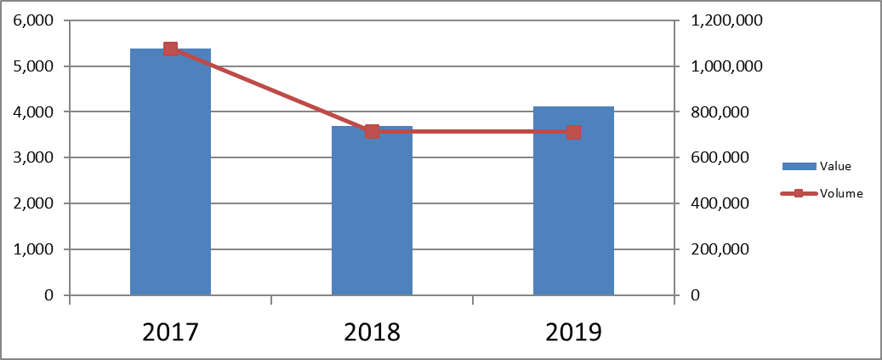
Q1-Q3 2019 Graph Comparison

Slide 8
3 years Comparison Top 20 Customers Sales Behavior

Slide 9
3 years Comparison Top 20 Customers Sales Behavior

Slide 10
3 years Comparison Top 20 Customers Sales Behavior

Slide 11
3 years Comparison Top 20 Customers Sales Behavior

Slide 12
3 years Comparison Top 20 Customers Sales Behavior

Slide 13
3 years Comparison Top 20 Customers Sales Behavior

Slide 14
3 years Comparison Top 20 Customers Sales Behavior

Slide 15
3 years Comparison Top 20 Customers Sales Behavior

Slide 16
3 years Comparison Top 20 Customers Sales Behavior

Slide 17
Sales By Principals(Q1-Q3 2019)

Slide 18
Sales By Principles Vs Product Category(2 main principals)

Slide 19
Q1-Q3 2019 New Business

Slide 20
Q1-Q3(Actual) and Q4(Forecast) 2019

Slide 21
FY 2019(Budget) Vs FY 2019(EST)

Slide 22
Q4 2019 New Business

Slide 23
Sales Budget 2020

Slide 24
Sales By Principals

Slide 25
Sales By Principles Vs Product Category(2 main principals)

Slide 26
2020 New Business

Slide 27
The End

